Slide 1
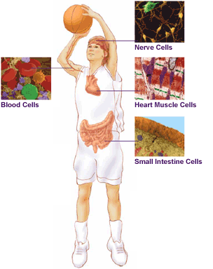
6.1 Chromosomes & Meiosis (Cell Division Part 2)
You have body cells and gametes
Human cells are divided into two main groups:
Somatic Cells &
Gametes

Slide 2
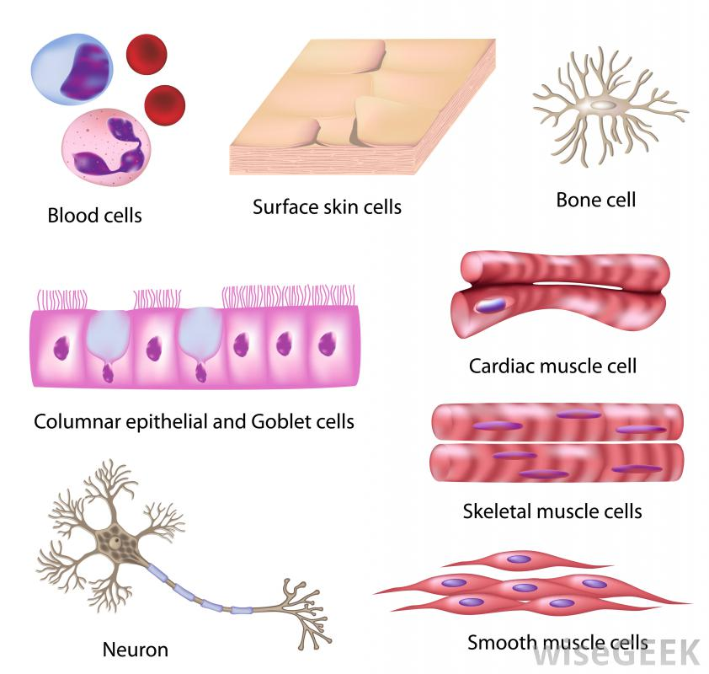
Somatic cells, or body cells, make up body tissues and organs.
-DNA in somatic cells is not passed on to offspring

Slide 3
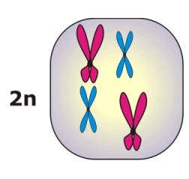
Body cells & gametes have different numbers of chromosomes
Body cells are diploid, meaning each body cell has two copies of each chromosome: one copy from the mother and one from the father.
Diploid cells are represented by (2n)

Slide 4
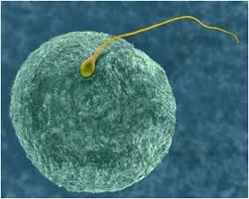
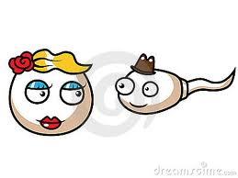
Gametes are sex cells
-DNA in the sex cells can be passed to offspring.
Males produce
sperm and females
produce eggs.

Slide 5
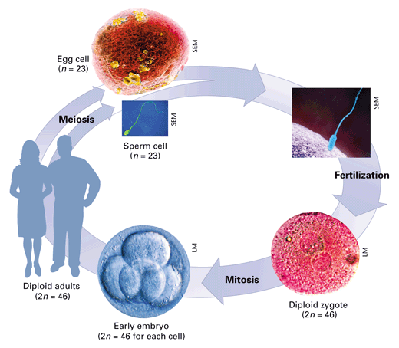
Gametes are haploid cells, meaning that they only have one copy of each chromosome.
Haploid cells are represented by (n)

Slide 6
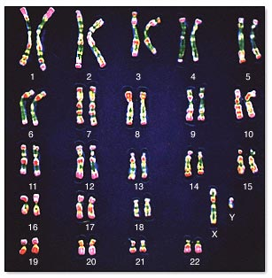
The normal number of chromosomes in human body cells is 46 total or 23 homologous pairs.

Slide 7
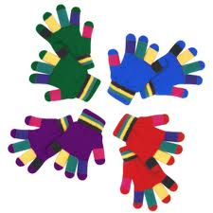
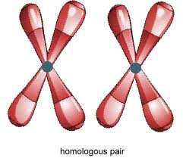
Homologous chromosomes are pairs of chromosomes, one inherited from the mother, one from the father, that have the same length and appearance.

Slide 8
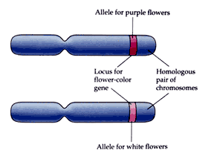
Homologous chromosomes have copies of the same genes, although the two copies may differ. The different copies are called alleles.

Slide 9
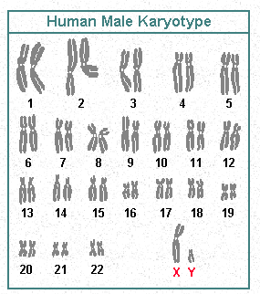
Chromosomes are different sizes
Each pair of chromosomes has been assigned a number, from biggest to smallest. (1-23)

Slide 10
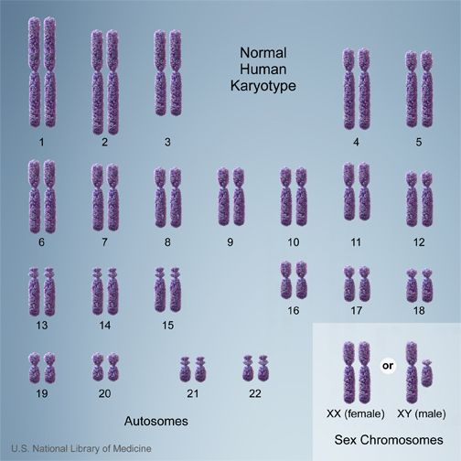
Human chromosome pairs 1 through 22 are called autosomes.

Slide 11
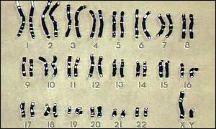
Autosomes are chromosomes that contain genes for characteristics not related to the sex of an organism.

Slide 12
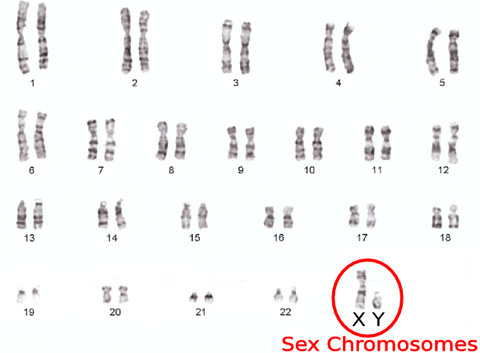
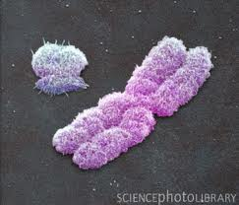
The 23rd chromosome pair in humans are sex chromosomes.

Slide 13
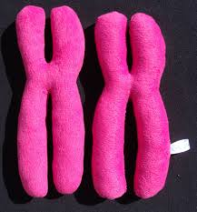
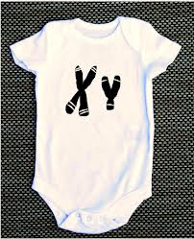
In humans, an organism with two X chromosomes is a female
An organism with an X andY chromosome is a male

Slide 14
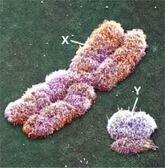
The larger X chromosome contains numerous genes, many unrelated to sexual characteristics
The Y chromosome directs the development of male sexual characteristics and carries few genes

Slide 15
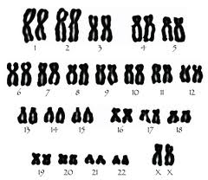
A karyotype looks at all of the chromosome pairs in order. What is the sex of this human?

Slide 16
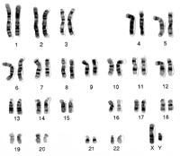
How about this one?

Slide 17
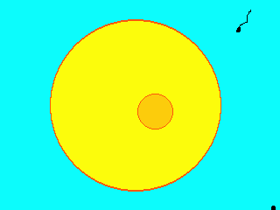
The fusion of an egg and sperm is called fertilization.
The fertilized egg becomes a zygote

Slide 18
6.2 Process of Meiosis
Meiosis divides the number of chromosomes in the gamete to add up to the number of chromosomes in the parent body cells.
Diploid (2n) → Haploid (n)

Slide 19
KEY CONCEPT During meiosis, diploid cells undergo two cell divisions that result in haploid cells

Slide 20
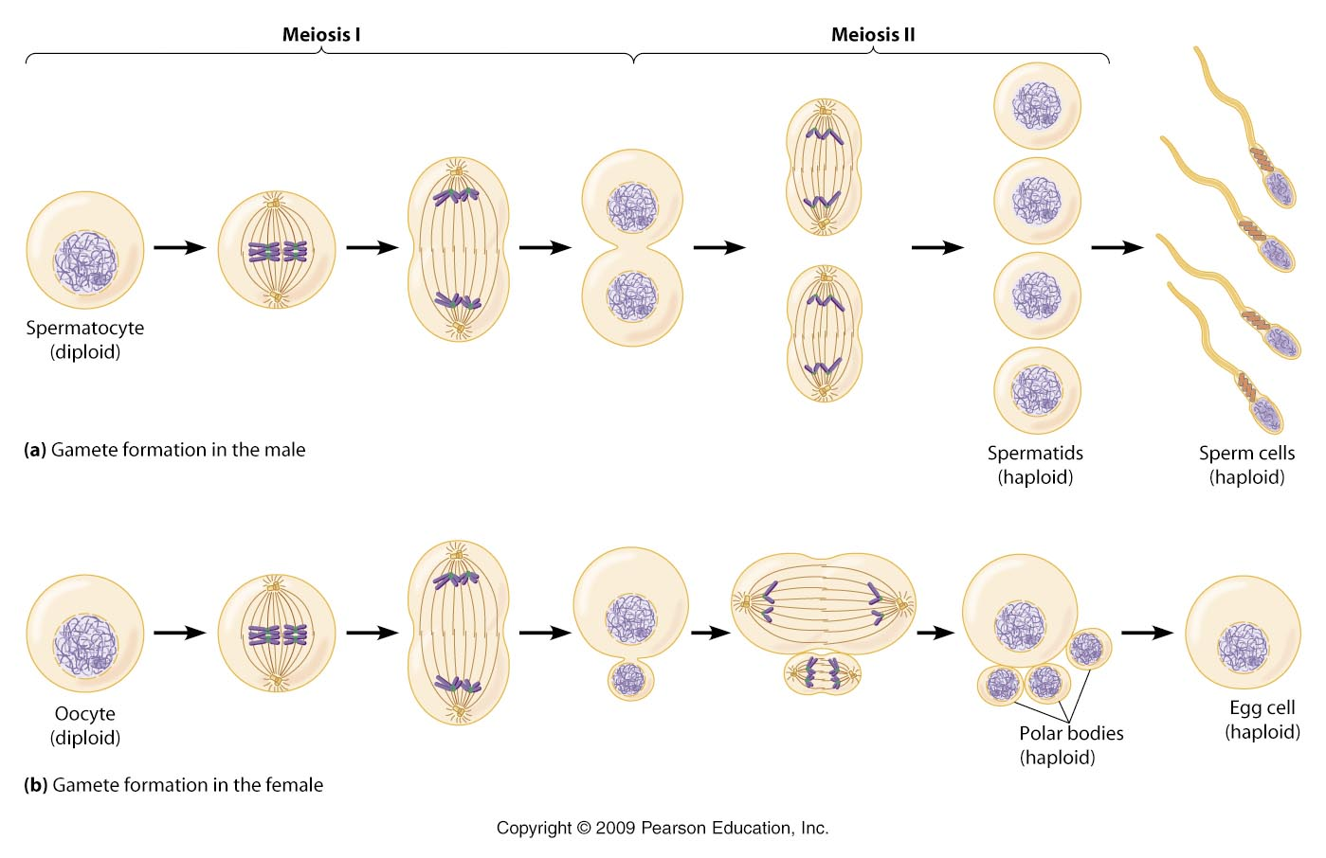

Slide 21
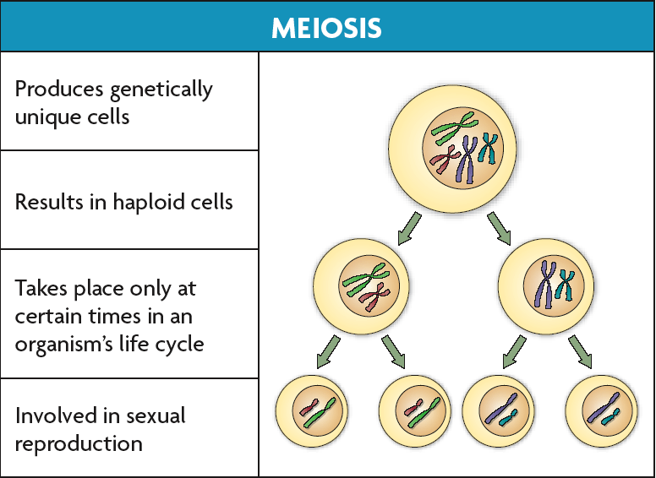
Cells go through two rounds of division in meiosis: meiosis I and meiosis II
Meiosis creates genetic diversity

Slide 22
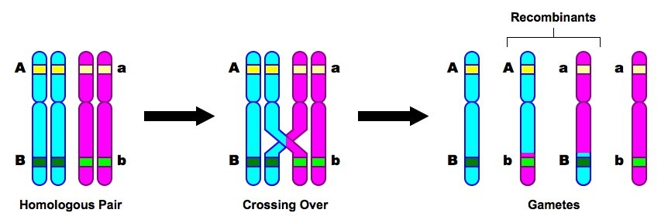
Some REALLY important things happen during Prophase I
1. The homologous chromosomes line up to create a tetrad.
2. The inner most chromosomes then cross over.
By crossing over, the cells have a higher genetic diversity.
Tetrad
In the picture, the letters represent alleles (different versions of the same gene). The inner most chromatids overlap. When they separate, they have swapped some their alleles.

Slide 23
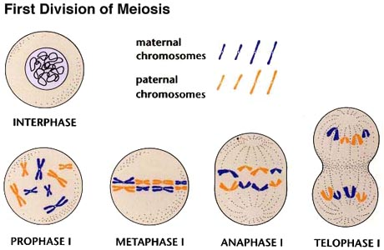
During meiosis I, homologous chromosomes pair up along the cell equator and are divided into separate cells.

Slide 24
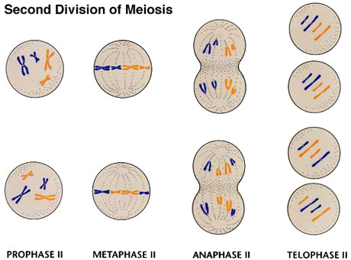
In meiosis II, sister chromatids are divided into separate cells making a total of four genetically unique haploid cells.

Slide 25
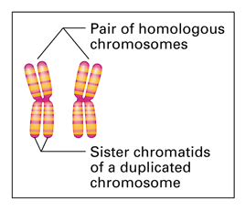
Homologous Chromosomes and Sister Chromatids
Homologous chromosomes are two separate chromosomes-one from the mother and one from the father
They carry the same genes, but different versions of each gene.

Slide 26
Each half of a duplicated chromosome is called a chromatid.

Slide 27
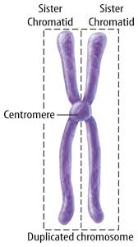
Sister chromatids are duplicated chromosomes that remain attached to each other.

